Slide 1


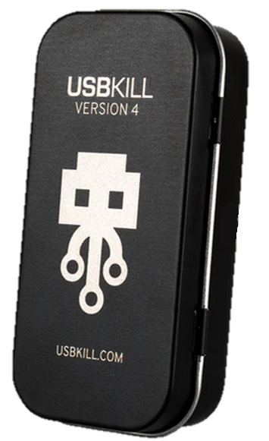
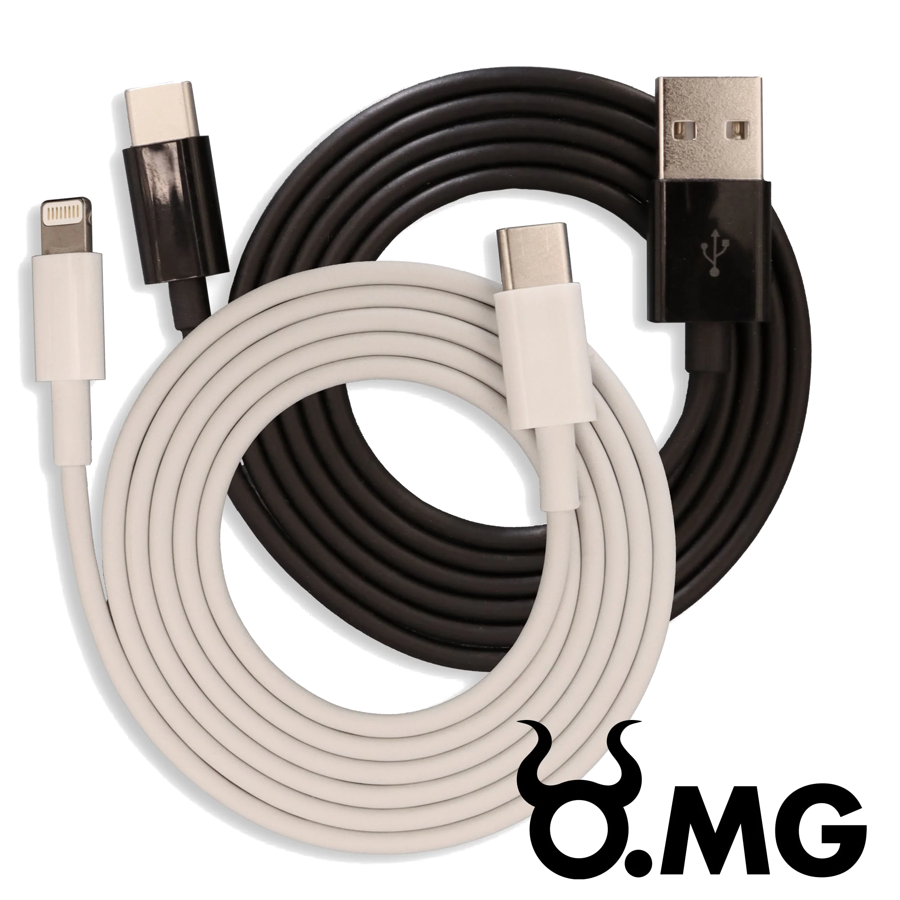

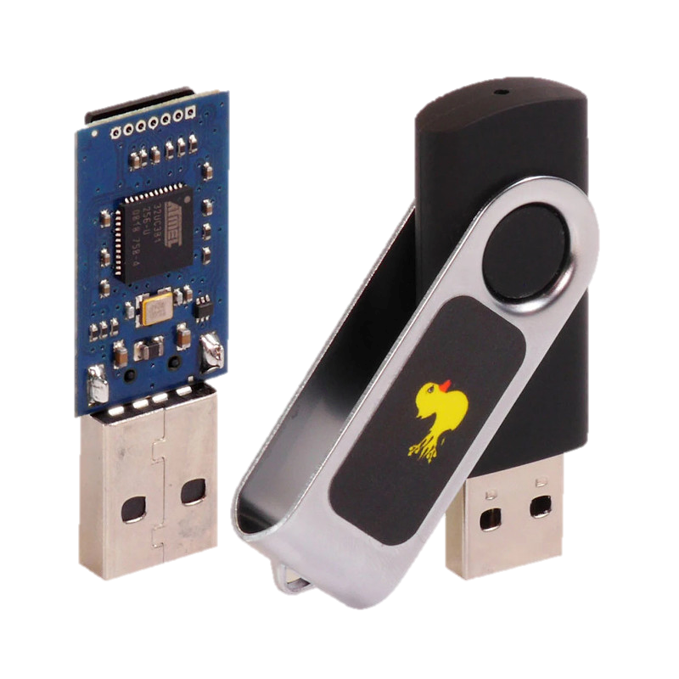
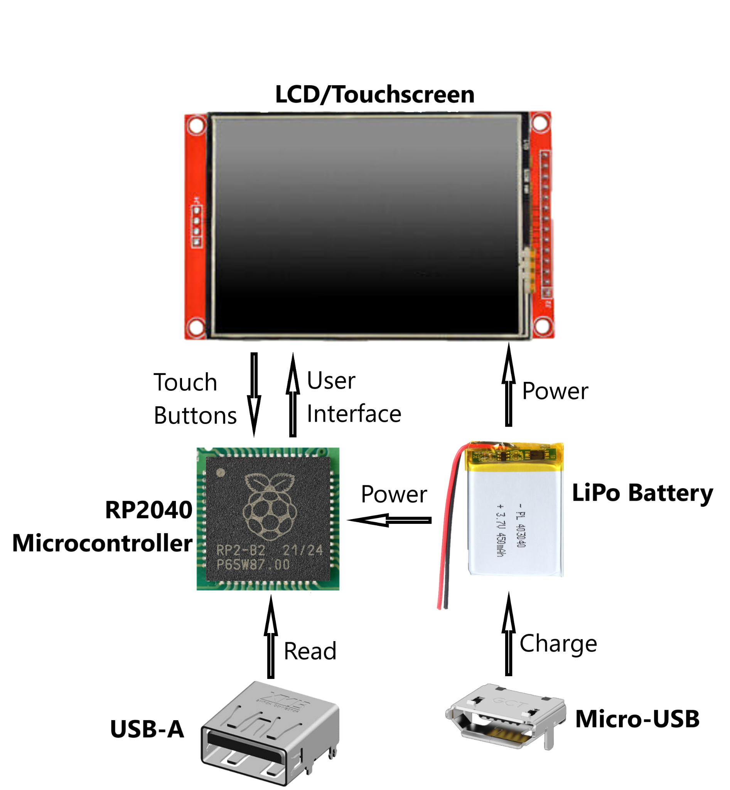


USB Defense
Sean Yocum and Vince Bengco
Department of Electrical and Computer Engineering
Introduction
How It Works
Cyber Discussion
Welcome to USB Defense, your computer's defender against potential USB threats.
Malicious USB devices can be designed to steal sensitive information from your computer, such as personal data, login credentials, or financial information.
Our project is designed to reveal the unknown aspects of such USB devices.
When a new device is plugged into a computer it must request access by using an Identification of a HID.
Since a malicious device must act like an HID to gain access we can use that vulnerability against them.
With the dangers of cyber becoming more and more apparent, strategies usually involving attackers and defenders (Red vs Blue Teams) have been developed to counteract possible devastating consequences.
One way attackers are able to infiltrate devices is manipulating humans through the use of Social Engineering, such as Pretexting Attacks.
“This involves a malicious actor pretending to be someone else in order to gain access to confidential information.” For example, hiding as Flash Drives, Charging Cables, and more.
Such devices are easily available for purchase from online stores like the “https://shop.hak5.org/”. Which consists of O.MG Cables, USB Rubber Ducky, and more devices.
Malicious Device Attacks
With the help of the user input such as the physical description of the device we can compare it with the Identification it gave our device.
After a comparison of the two we can conclude whether it is maliciously hiding information from the user.
A malicious device is something that camouflages as a simple flash drive or cable to entice people to use it.
However, it does not act as such devices, it uses its microcontroller which acts like an HID to gain full access to the computer.
Basic Hardware Diagram
What are HID’s?
HID’s also known as Human Interface Device are any devices that lets humans interact with the computer, such as a keyboard or mouse.
Learn To Protect Your Computer From USB Attacks
Acknowledgements
Instructor: Dr. Grzegorz Chmaj
Faculty Advisor: Dr. Russel Jacob Baker
It is safe to assume, that any and everything is potentially compromised when plugging anything into your computer.
If the USB must be utilized to update patches/firmware, use Intrusion Detection Systems(IDS) or Intrusion Prevention Systems(IPS) to determine its intent.
References
User Awareness is key when dealing with USB Attacks.

